Slide 1
Shell Scripting
Week 2 Lecture 2.1

Slide 2
The Shell
The shell is a user’s interface to the OS
Used to run programs

Slide 3
Scripting Languages and Compiled Languages
Compiled Languages
  Examples? C/C++, Java
  Programs are translated from their original source code into object code, executed by hardware
  Efficient
  Work at low level, dealing with bytes, integers, floating points, etc
Scripting languages
  Interpreted
  An interpreter reads a program, and executes it line by line
  Examples?
    Python
    JavaScript

Slide 4
Some Commands
cat – concatenate and print files.
Examples –
  cat 01.txt
  to display the contents of file 01.txt.
  cat 01.txt 02.txt
  to display the contents of both files.
  cat file1.txt file2.txt > file3.txt
  reads file1.txt and file2.txt and combines those files to make file3.txt.
  cat note5 >> notes
  attach note5 to notes.
  cat > file1
  write content to a new file file1 or overwrite file1 if it exists.
  cat >> file1
  add additional content to file1.

Slide 5
Example
$ who
george pts/2 Dec 31 16:39 (valley-forge.example.com)
betsy pts/3 Dec 27 11:07 (flags-r-us.example.com)
benjamin dtlocal Dec 27 17:55 (kites.example.com)
jhancock pts/5 Dec 27 17:55 (:32)
Camus pts/6 Dec 31 16:22
tolstoy pts/14 Jan 2 06:42
What does the above command do?
How to count the total number of users logged in?
$ who | wc -l Count users
6

Slide 6
Simple Output with echo
$ echo Now is the time for all good men
Now is the time for all good men
$ echo to come to the aid of their country.
to come to the aid of their country.
There is also fancier output with printf, which can refer to its man page for

Slide 7
Basic I/O Redirection
Most programs read from stdin
Write to stdout
Send error messages to stderr
$ cat With no arguments, read standard input, write standard output
now is the time Typed by the user
now is the time Echoed back by cat
for all good men
for all good men
to come to the aid of their country
to come to the aid of their country
^D Ctrl-D, End of file

Slide 8
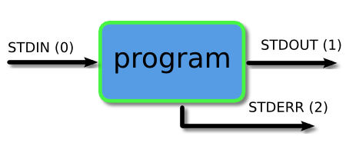
Piping and Redirection
Every program we run on the command line automatically has three data streams connected to it.
  STDIN (0) - Standard input (data fed into the program)
  STDOUT (1) - Standard output (data printed by the program, defaults to the terminal)
  STDERR (2) - Standard error (for error messages, also defaults to the terminal)
Piping and redirection is the means by which we may connect these streams between programs and files to direct data in useful ways.

Slide 9
Some more commands
grep - “global regular expression print”. It processes text line by line and prints any lines which match a specified pattern.
Example –
  ls -l > allFileListing
  grep csgrad allFileListing
  Alternatively, ls -l | grep csgrad

Slide 10
Pipe
It lets you feed the output from the program on the left as input to the program on the right.
Example –
  ls | head -3
    barry.txt
    bob
    example.png
  ls | head -3 | tail -1
    example.png

Slide 11
sort, comm, cmp and tr
sort: sorts lines of text files
        Usage: sort [OPTION]… [FILE]…
comm: compare two sorted files line by line
    Usage: comm [OPTION]… FILE1 FILE2
    comm -23 file1 file2
    Todo: Find the difference between comm, diff and cmp
    cmp: compare two files byte by byte. If a difference is found, it reports the byte and line number where the first difference is found. Exit status is 0 if files identical, 1 if different and 2 if problem encountered.
      Usage: cmp [OPTION]… FILE 1 FILE2
tr: translate or delete characters
        Usage: tr [OPTION]…SET1 [SET2]
        echo "password a1b2c3" | tr -d [:digit:] -> password abc
        echo “abc” | tr [:lower:] [:upper:] -> ABC

Slide 12
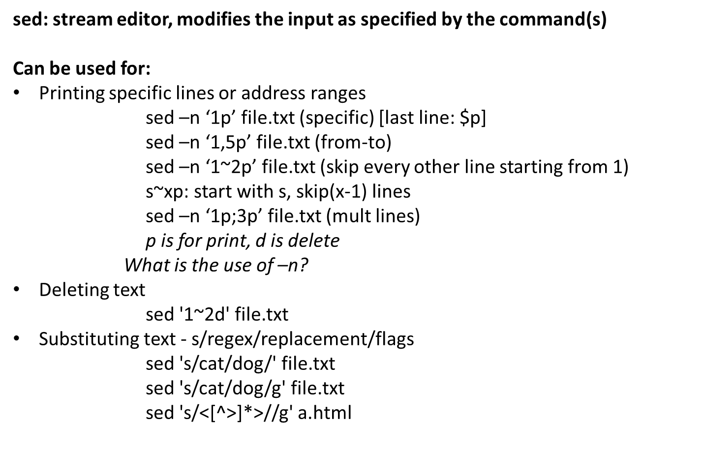
Sed (link: http://bit.ly/2DeoG4p)

Slide 13
More sed examples
sed -n 12,18p file.txt
sed 12,18d file.txt
sed '1~3d' file.txt
sed '1,20 s/Johnson/White/g' file.txt Replace Pattern1 with Pattern2 in first 20 lines
sed –n ‘/pattern/p’ filename Print lines having Pattern
sed ‘s/pattern1/pattern2/’ filename Replace Pattern1 with Pattern2 (First Occurrence )
sed ‘s/pattern1/pattern2/g’ filename Replace Pattern1 with Pattern2 (whole file)
sed '/pattern/d' file.txt
sed '/regexp/!d' file.txt
Link: https://www.amitnepal.com/sed-tutorial-with-examples/

Slide 14
Regular Expressions
Quantification
- How many times of previous expression?
- Most common quantifiers: ?(0 or 1), *(0 or more), +(1 or more)
Alternation
- Which choices?
- Operators: [] and |
Hello|World [A B C]
Anchors
- Where?
- Characters: ^ (beginning) and $ (end)

Slide 15
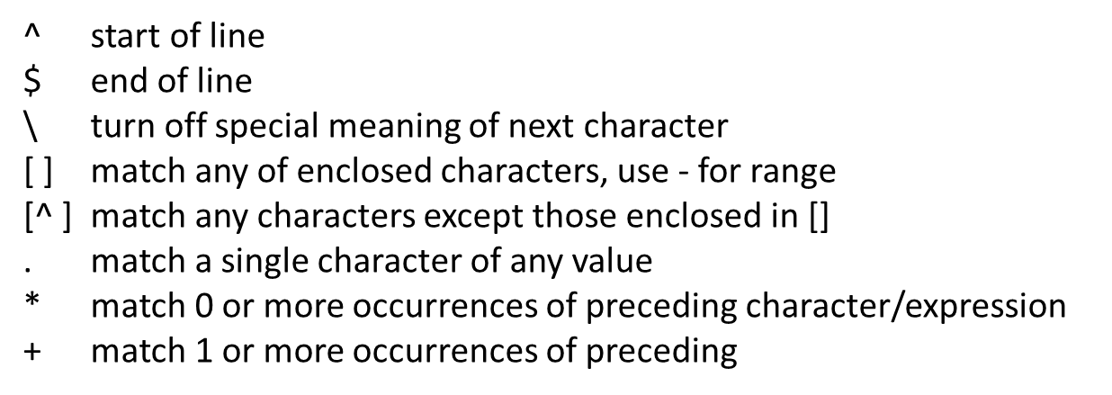
Regular Expressions

Slide 16
Quoting - To preserve literal meaning of special characters
Escape Character \ - Literal value of following character
  echo \|
Single Quote - Literal Meaning of all within ‘’
  hello=1
  str=‘$hello’ # saves value as string $hello
  str=“$hello” #saves value stored in variable hello
  echo $str
Double Quote - Literal meaning except for $, ` and \.
  hello=1
  str=“abc$hello”
  echo $str
  Output : abc1
  Backquote - execute the command
  echo `ls` -> prints result after running ls

Slide 17
Task 1 (sed)
Create file with following text (singers.txt):
  1, Justin Timberlake
  2, Taylor Swift
  3, Mick Jagger
  4, Lady Gaga
  5, Johnny Trash
  6, Elvis Presley
  7, John Lennon
  Print all lines having ‘John’
    Ans: sed -n '/John/p’ singers.txt > johns.txt

Slide 18
Task 2 (grep & sed)
Checking for the given string in multiple files: grep "string" FILE_PATTERN
Create a file f1.txt and copy f1.txt to f2.txt
Content of f1.txt and f2.txt
  UPPER CASE LINE
  Lower case line
  Break;
  empty LINE
  Last line
Replace ‘Last line’ of f2.txt with ‘End line’ using sed and write to f3.txt
  Ans: sed 's/Last line/End line/' f2.txt > f3.txt
Check for the given string ‘line/LINE’ in text files which start with ‘f’ and end with a number using egrep and regex
  Ans: egrep 'line|LINE' f*[0-9].txt

Slide 19
Fun command: cron http://bit.ly/cron_
Linux Cron utility is an effective way to schedule a routine background job at a specific time and/or day on an on-going basis.
Wont be going in detail, search for it
View crontab entries
  Crontab –l
Example: Scheduling a Job For a Specific Time
  30 08 10 06 * /home/mithal/script
    30 – 30th Minute
    08 – 08 AM
    10 – 10th Day
    06 – 6th Month (June)
    * – Every day of the week

Slide 20
Shell Scripting
Week 2 Lecture 2.2

Slide 21
Clarifications
Files f1.txt f2.txt f3.txt:
UPPER CASE LINE
Lower case line
Break;
empty LINE
Last line
Grep <pattern allows regex> <filename does not use regex ^ . $>
Grep ‘line|LINE ' f*[0-9].txt
Vs
Grep ‘line|LINE‘ ^f*[0-9].txt$ -> won’t work as filename does not use regex but search pattern would

Slide 22
Shell Scripting
Shell: The shell provides you with an interface to the UNIX system.
    -It gathers input from you and executes programs based on that input.
    -When a program finishes executing, it displays that program's output.
Shell-script: A file containing shell commands (and comments - preceded by #) to execute
    - The #! First Line (shebang): a way to tell the kernel which shell to use for a script
    #!/bin/bash
    - Make it executable: chmod +x scriptFile
    - Execute: bash path_to_script/scriptFile

Slide 23
Self-Contained Scripts: The #! First Line
When the shell runs a program, it asks the kernel to start a new process and run the given program in that process.
It knows how to do this for compiled programs but for a script, the kernel will fail, returning a “not executable format file” error so it’ll start a new copy of /bin/sh (the standard shell) to run the program.
But if there is more than one shell installed on the system, we need a way to tell the kernel which shell to use for a script
  #! /bin/csh –f
  #! /bin/awk –f
  #! /bin/sh

Slide 24
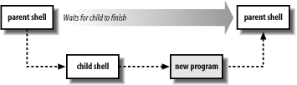
Basic Shell Constructs
Shell recognizes three fundamental kinds of commands
  Built-in commands: Commands that the shell itself executes
  Shell functions: Self-contained chunks of code, written in shell language
  External commands

Slide 25
Shell Programming Constructs
Variables
Valid character string [a-zA-Z0-9_] to which a value is assigned
    var_name=var_value !!No spaces around =!!
Access using $: echo $var_name
Special Variables: certain characters reserved as special variables
    $: PID of current shell
    #: number of arguments the script was invoked with
    n: nth argument to the script
    ?: exit status of the last command executed
    echo $$; echo $#; echo $2; echo $?;
scalar variable vs array variable:
    array_name[index]=value; echo ${array_name[index]}

Slide 26
Variables
Start with a letter or underscore and may contain any number of following letters, digits, or underscores
Hold string variables
$ myvar=this_is_a_long_string_that_does_not_mean_much Assign a value
$ echo $myvar Print the value
this_is_a_long_string_that_does_not_mean_much
first=isaac middle=bashevis last=singer Multiple assignments allowed on one line
fullname="isaac bashevis singer" Use quotes for whitespace in value
oldname=$fullname Quotes not needed to preserve spaces in value
fullname="$first $middle $last" Double quotes required here, for concatenating

Slide 27
Accessing Shell Script Arguments
Example:
$ who | grep betsy Where is betsy?
betsy pts/3 Dec 27 11:07
Script:
#! /bin/sh
# finduser --- see if user named by first argument is logged in
who | grep $1
Run it:
$ chmod +x finduser Make it executable
$ ./finduser betsy Test it: find betsy
betsy pts/3 Dec 27 11:07
$ ./finduser benjamin Now look for Ben
benjamin dtlocal Dec 27 17:55

Slide 28
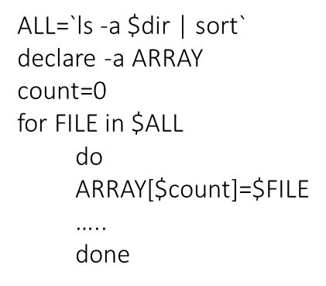
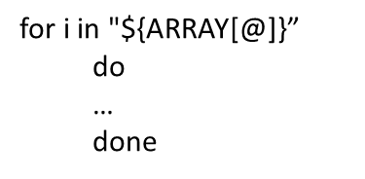
Looping
for var in list_values
    do
      command 1
      ..
      command n
    done
while condition
    do
      command 1
      ..
      command n
    done

Slide 29
Loops - Bash example
arr=("a 1" "b" "c") for i in "${arr[@]}"; do echo $i; done for i in ${arr[@]}; do echo $i; done
Difference noticed in elements having spaces
END=5
for ((i=1;i<=END;i++)); do
echo $i
done
# ==> outputs 1 2 3 4 5 on separate lines

Slide 30
Loops - Bash example
array=(one two three four [5]=five)
echo "Array size: ${#array[*]}" #prints count of elements
echo "Array indexes:"
for index in ${!array[*]} #iterates over it
do
echo $index
done for index in ${array[*]}
do
echo $index
#prints elements themselves
Done
for index in ${array[@]}
Do
printf "%d\n" $index
#error
done
for index in ${!array[* or @]}
Do
echo "%d\n" ${array[$index]}
#prints elements using indexes
done
*no need to be worried about this

Slide 31
Program - counter
#!/bin/bash
count=1
while [ $count -le 9 ]
do
echo "$count"
sleep 1
(( count++ ))
done

Slide 32
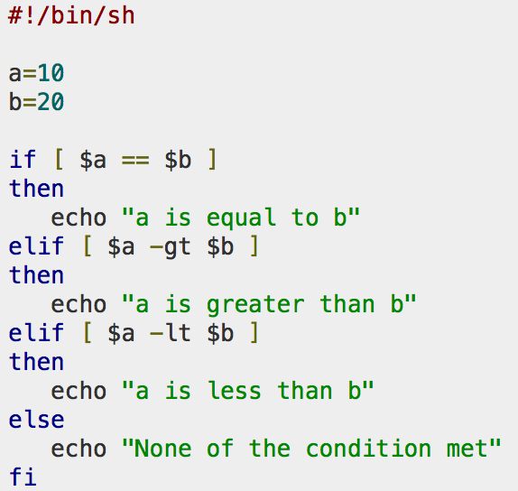
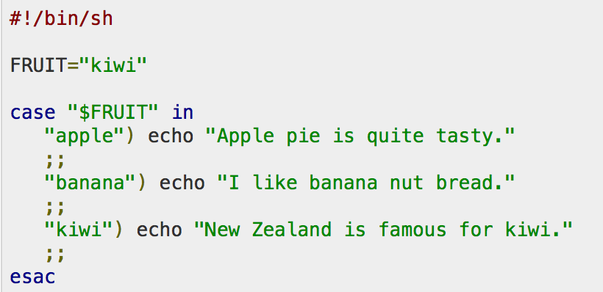
Conditional
if…then…fi
if…then…else…fi
if…then…elif..then…fi
case…esac
Unconditional
break
continue

Slide 33
Redirection and Pipelines
Use program < file to make program's standard input be file:
tr -d '\r' < dos-file.txt
Use program > file to make program's standard output be file:
tr -d '\r' < dos-file.txt > unix-file.txt
Use program >> file to send program's standard output to the end of file.
for f in dos-file*.txt
do
tr -d '\r' < $f >> big-unix-file.txt
done
Use program1 | program2 to make the standard output of program1 become the standard input of program2.
tr -d '\r' < dos-file.txt | sort > unix-file.txt
Write a line in a text file (lang.txt) and replace ‘g’ with ‘b’
cat lang.txt | tr 'g' 'b'

Slide 34
Basic Command Searching
$PATH variable is a list of directories in which commands are found
$ echo $PATH /bin:/usr/bin:/usr/X11R6/bin:/usr/local/bin

Slide 35
Accessing Shell Script Arguments
Positional parameters represent a shell script’s command-line arguments
For historical reasons, enclose the number in braches if it’s greater than 9.
  echo first arg is $1
  echo tenth arg is ${10}

Slide 36
Simple Execution Tracing
To get shell to print out each command as it executes add this in the script:
set –x: to turn it on
set +x: to turn it off

Slide 37
Searching for Text
grep: Uses basic regular expressions (BRE)
egrep: Extended grep that uses extended regular expressions (ERE)
Fgrep: Fast grep that matches fixed strings instead of regular expressions.

Slide 38
Simple grep
$ who Who is logged on
tolstoy tty1 Feb 26 10:53
tolstoy pts/0 Feb 29 10:59
tolstoy pts/1 Feb 29 10:59
tolstoy pts/2 Feb 29 11:00
tolstoy pts/3 Feb 29 11:00
tolstoy pts/4 Feb 29 11:00
austen pts/5 Feb 29 15:39 (mansfield-park.example.com)
austen pts/6 Feb 29 15:39 (mansfield-park.example.com)
$ who | grep -F austen Where is austen logged on?
austen pts/5 Feb 29 15:39 (mansfield-park.example.com)
austen pts/6 Feb 29 15:39 (mansfield-park.example.com)

Slide 39
Regular Expressions
Table 3-1. POSIX BRE and ERE metacharacters
Notation that lets you search for text that fits a particular criterion, such as “starts with the letter a”
Which commands/programming languages support regular expressions?
vi, tr, rename, grep, sed, awk, perl, python etc.

Slide 40
Regular expressions
Character | BRE / ERE | Meaning in a pattern
\ | Both | Usually, turn off the special meaning of the following character. Occasionally, enable a special meaning for the following character, such as for \(...\) and \{...\}.
. | Both | Match any single character except NULL. Individual programs may also disallow matching newline.
* | Both | Match any number (or none) of the single character that immediately precedes it. For EREs, the preceding character can instead be a regular expression. For example, since . (dot) means any character, .* means "match any number of any character." For BREs, * is not special if it's the first character of a regular expression.
^ | Both | Match the following regular expression at the beginning of the line or string. BRE: special only at the beginning of a regular expression. ERE: special everywhere.

Slide 41
Regular Expressions (cont’d)
$ | Both | Match the preceding regular expression at the end of the line or string. BRE: special only at the end of a regular expression. ERE: special everywhere.
[...] | Both | Termed a bracket expression, this matches any one of the enclosed characters. A hyphen (-) indicates a range of consecutive characters. A circumflex (^) as the first character in the brackets reverses the sense: it matches any one character not in the list. A hyphen or close bracket (]) as the first character is treated as a member of the list. All other metacharacters are treated as members of the list (i.e., literally). Bracket expressions may contain collating symbols, equivalence classes, and character classes (described shortly).
\{n,m\} | BRE | Termed an interval expression, this matches a range of occurrences of the single character that immediately precedes it. \{n\} matches exactly n occurrences, \{n,\} matches at least n occurrences, and \{n,m\} matches any number of occurrences between n and m. n and m must be between 0 and RE_DUP_MAX (minimum value: 255), inclusive.
\( \) | BRE | Save the pattern enclosed between \( and \) in a special holding space. Up to nine subpatterns can be saved on a single pattern. The text matched by the subpatterns can be reused later in the same pattern, by the escape sequences \1 to \9. For example, \(ab\).*\1 matches two occurrences of ab, with any number of characters in between.

Slide 42
Regular Expressions (cont’d)
\n | BRE | Replay the nth subpattern enclosed in \( and \) into the pattern at this point. n is a number from 1 to 9, with 1 starting on the left.
{n,m} | ERE | Just like the BRE \{n,m\} earlier, but without the backslashes in front of the braces.
+ | ERE | Match one or more instances of the preceding regular expression.
? | ERE | Match zero or one instances of the preceding regular expression.
| | ERE | Match the regular expression specified before or after.
( ) | ERE | Apply a match to the enclosed group of regular expressions.

Slide 43
Note
. means "any character"
* means "any number of this"
.* therefore means an arbitrary string of arbitrary length
^ indicates the beginning of the string
$ indicates the end of the string

Slide 44
Examples
Expression | Matches
tolstoy | The seven letters tolstoy, anywhere on a line
^tolstoy | The seven letters tolstoy, at the beginning of a line
tolstoy$ | The seven letters tolstoy, at the end of a line
^tolstoy$ | A line containing exactly the seven letters tolstoy, and nothing else
[Tt]olstoy | Either the seven letters Tolstoy, or the seven letters tolstoy, anywhere on a line
tol.toy | The three letters tol, any character, and the three letters toy, anywhere on a line
tol.*toy | The three letters tol, any sequence of zero or more characters, and the three letters toy, anywhere on a line (e.g., toltoy, tolstoy, tolWHOtoy, and so on)

Slide 45
POSIX Bracket Expressions
Class | Matching characters | Class | Matching characters
[:alnum:] | Alphanumeric characters | [:lower:] | Lowercase characters
[:alpha:] | Alphabetic characters | [:print:] | Printable characters
[:blank:] | Space and tab characters | [:punct:] | Punctuation characters
[:cntrl:] | Control characters | [:space:] | Whitespace characters
[:digit:] | Numeric characters | [:upper:] | Uppercase characters
[:graph:] | Nonspace characters | [:xdigit:] | Hexadecimal digits

Slide 46
Backreferences
Match whatever an earlier part of the regular expression matched
  Enclose a subexpression with \( and \).
  There may be up to 9 enclosed subexpressions and may be nested
  Use \digit, where digit is a number between 1 and 9, in a later part of the same pattern.
Pattern | Matches
\(ab\)\(cd\)[def]*\2\1 | abcdcdab, abcdeeecdab, abcdddeeffcdab, ...
\(why\).*\1 | A line with two occurrences of why
\([[:alpha:]_][[:alnum:]_]*\) = \1; | Simple C/C++ assignment statement

Slide 47
Matching Multiple Characters with One Expression
* | Match zero or more of the preceding character
\{n\} | Exactly n occurrences of the preceding regular expression
\{n,\} | At least n occurrences of the preceding regular expression
\{n,m\} | Between n and m occurrences of the preceding regular expression

Slide 48
Operator Precedence (High to Low)
Operator | Meaning
[. .] [= =] [: :] | Bracket symbols for character collation
\metacharacter | Escaped metacharacters
[ ] | Bracket expressions
\( \) \digit | Subexpressions and backreferences
* \{ \} | Repetition of the preceding single-character regular expression
no symbol | Concatenation
^ $ | Anchors

Slide 49
POSIX Built-in Shell Variables
Variable | Meaning
# | Number of arguments given to current process.
@ | Command-line arguments to current process. Inside double quotes, expands to individual arguments.
* | Command-line arguments to current process. Inside double quotes, expands to a single argument.
- (hyphen) | Options given to shell on invocation.
? | Exit status of previous command.
$ | Process ID of shell process.
0 (zero) | The name of the shell program.
! | Process ID of last background command. Use this to save process ID numbers for later use with the wait command.
ENV | Used only by interactive shells upon invocation; the value of $ENV is parameter-expanded. The result should be a full pathname for a file to be read and executed at startup. This is an XSI requirement.
HOME | Home (login) directory.
IFS | Internal field separator; i.e., the list of characters that act as word separators. Normally set to space, tab, and newline.
LANG | Default name of current locale; overridden by the other LC_* variables.
LC_ALL | Name of current locale; overrides LANG and the other LC_* variables.
LC_COLLATE | Name of current locale for character collation (sorting) purposes.
LC_CTYPE | Name of current locale for character class determination during pattern matching.
LC_MESSAGES | Name of current language for output messages.
LINENO | Line number in script or function of the line that just ran.
NLSPATH | The location of message catalogs for messages in the language given by $LC_MESSAGES (XSI).
PATH | Search path for commands.
PPID | Process ID of parent process.
PS1 | Primary command prompt string. Default is "$ ".
PS2 | Prompt string for line continuations. Default is "> ".
PS4 | Prompt string for execution tracing with set -x. Default is "+ ".
PWD | Current working directory.

Slide 50
Arithmetic Operators
Operator | Meaning | Associativity
++ -- | Increment and decrement, prefix and postfix | Left to right
+ - ! ~ | Unary plus and minus; logical and bitwise negation | Right to left
* / % | Multiplication, division, and remainder | Left to right
+ - | Addition and subtraction | Left to right
<< >> | Bit-shift left and right | Left to right
< <= > >= | Comparisons | Left to right
= = != | Equal and not equal | Left to right
& | Bitwise AND | Left to right
^ | Bitwise Exclusive OR | Left to right
| | Bitwise OR | Left to right
&& | Logical AND (short-circuit) | Left to right
|| | Logical OR (short-circuit) | Left to right
?: | Conditional expression | Right to left
= += -= *= /= %= &= ^= <<= >>= |= | Assignment operators | Right to left

Slide 51
Exit: Return value
Value | Meaning
0 | Command exited successfully.
> 0 | Failure during redirection or word expansion (tilde, variable, command, and arithmetic expansions, as well as word splitting).
1-125 | Command exited unsuccessfully. The meanings of particular exit values are defined by each individual command.
126 | Command found, but file was not executable.
127 | Command not found.
> 128 | Command died due to receiving a signal.

Slide 52
if-elif-else-fi
if condition
then
statements-if-true-1
[ elif condition
then
statements-if-true-2
... ]
[ else
statements-if-all-else-fails ]
fi

Slide 53
Example
if grep pattern myfile > /dev/null
then
... Pattern is there
else
... Pattern is not there
fi

